Slide 2
FILM & CREATIVE INDUSTRIES

Slide 3
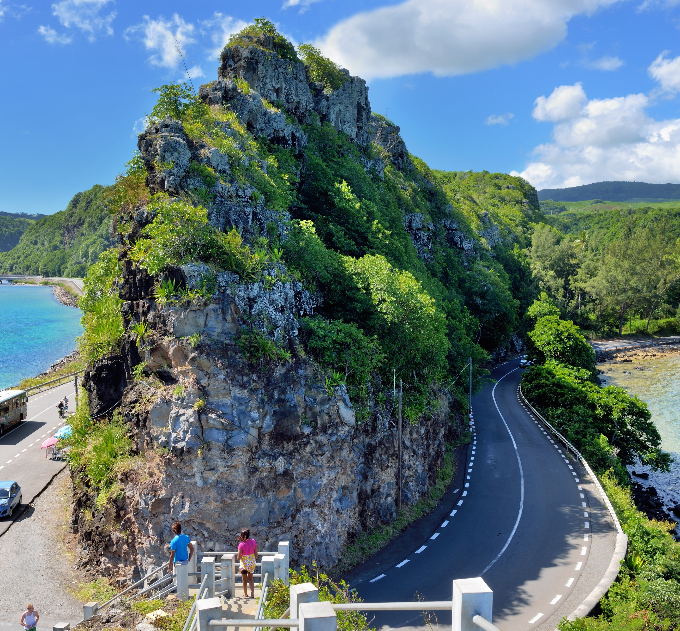
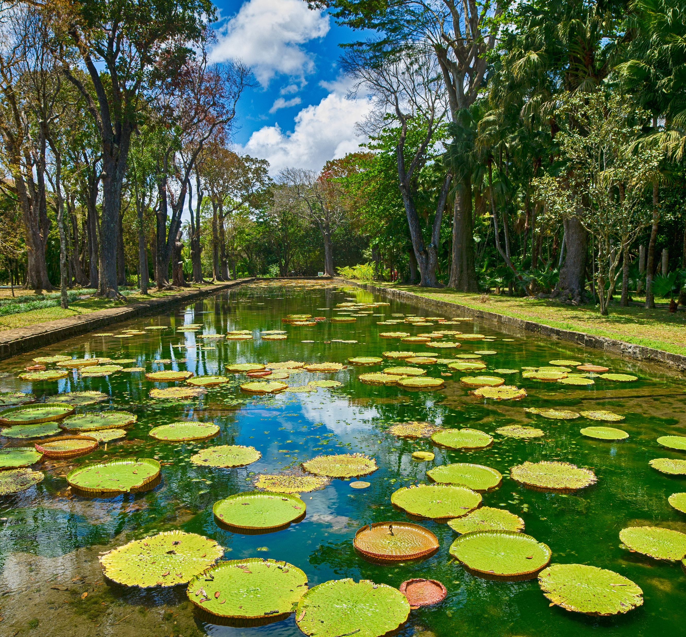
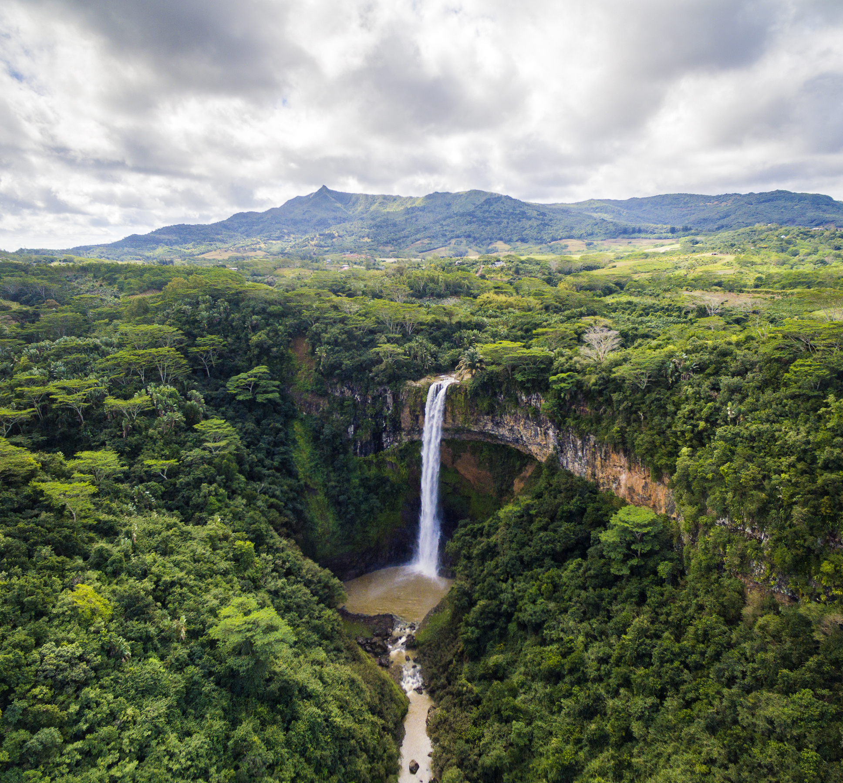
The Film Rebate Scheme
The Film Rebate Scheme is a film incentive that provides local and foreign film producers with 30-40 percent reimbursement on audited Qualified Production Expenditure in Mauritius
25%
Budget 2012
30%
Budget 2013
Up to 40%
Budget 2016-2017
Introduction of a legal framework to encourage the setting up of a film industry in Mauritius.
Implementation of the film rebate scheme with up to 25% of Qualifying Production Expenditures (QPE) reimbursed.
Increase of film rebate scheme to 30% on QPE.
Scheme extended to high end TV commercials and documentaries.
Introduction of a new band of 40% rebate for big budget feature films.

Slide 4
The Film Rebate Scheme - Categories of Production
FEATURE FILM
TV SERIES
DOCUMENTARIES
TVCOMMERCIALS & OTHER TV PROGRAMMES
MUSIC VIDEO & DUBBING
Duration 60 minutes or more
QPE of USD 100 000 or more (30% rebate)
QPE of USD 1,000,000 or more (up to 40% rebate)
Episode of drama television and TV Serials
Duration 60 minutes or more
QPE of USD 20 000 or more
QPE of USD 150,000 or more (up to 40% rebate)
Documentary programme, natural history, lifestyle magazine
QPE of USD 20 000 or more
QPE of USD 30 000 or more
QPE of USD 30 000 or more

Slide 5
Qualifying Production Expenditure
Pre-Production
Production
Post-Production
Ground transport and logistics
Remuneration for cast and crew
Travel to Mauritius (Flight and Marine Travel)
Hire of equipment and audio rentals
Location fees
Accommodation
Catering

Slide 6
Beneficiaries of the Film Rebate Scheme

Slide 7
Performance of the Film Rebate Scheme
121
Film projects completed under the Film Rebate Scheme since implementation in 2013
MUR
4.2 Bn
Spending by film producers in Mauritius

Slide 8
Creating an Export-Oriented Film Industry
Exemption of custom duties on purchase of film production equipment
Encourage distribution and sales in Mauritius
Tax incentive for export of content creation
Encourage Copyright Registration/Protection of Intellectual Property Rights
Financial support: Completion bond guarantee and Rebate discount facilities
100% foreign ownership with no minimum capital in company incorporated in Mauritius

Slide 9
Why Choose Mauritius?
One Stop Shop for permits & clearances
Political and economic stability
Hassle-free
experience for shooting
Financial support provided to film producers in the form of Film Financing
Sponsorship & Product Placement
Establishment of Hi-Tech Film Production Equipment companies
Availability of trained local crew
Line Producers with good track record

Slide 10
Creative Arts
VISION
Develop a sustainable business and economic model that ensures the long-term development of arts business
3.7% of GDP
Develop cultural entrepreneurship with local artists to unlock the potential of deriving revenue from cultural activity and art works
Promote Art as a new asset class
Develop of a Public Art Policy that will guide the promotion, development and commissioning of public art projects in Mauritius;
MUR 16 Billion GDP Contribution

Slide 11
Creative Arts – Key Achievements
National Arts Fund
EDB Art Gallery
Mauritius International Art Fair
More than 45 art projects funded
Some 100 artworks exhibited
Network of more than 120 artists

