Slide 2
Mauritius
A Centre of Excellence for Education

Slide 3
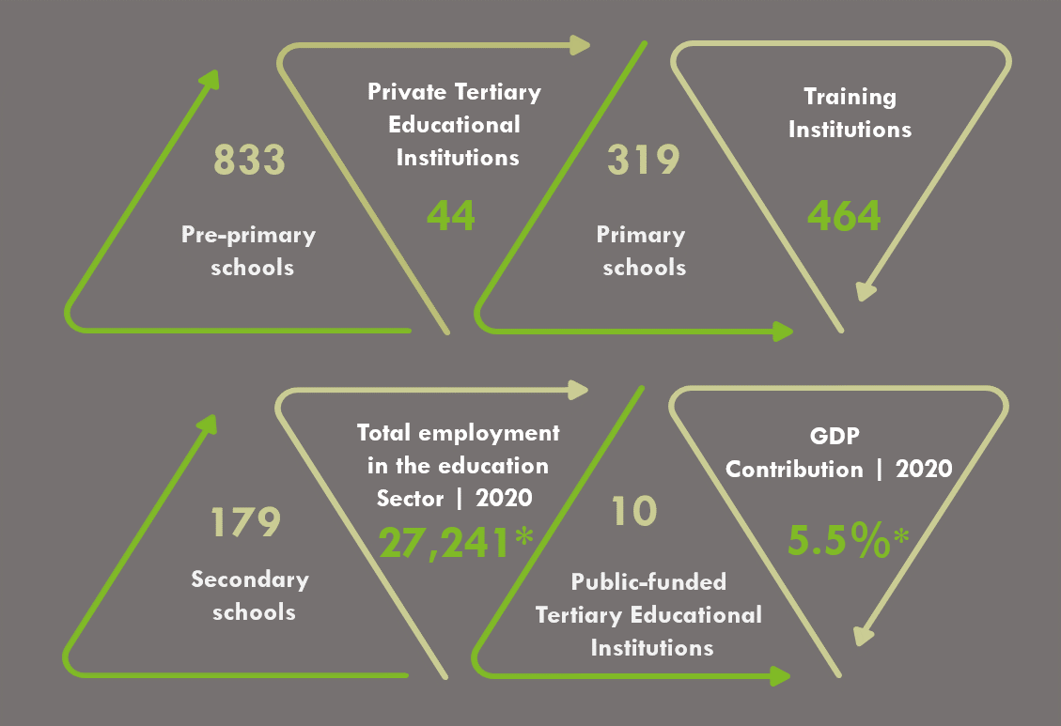
The Education Landscape of Mauritius

Slide 4
Tertiary Enrolment by Field of Study
Information
& Technology
7.3%
Science &
Technology
Education
6.9%
Medicine
26.2%
5.1%
6.2%
Engineering
Accounting
22%
Law
3.6%
17.3%
5.4%
Administration & Management
Others

Slide 5
International Presence
Global Players
International Affiliation

Slide 6
Main Source Countries of International Students
The vision of the Government is to triple the number of international students by 2030.
As at December 2020, there were 3300 international students from over 75 countries mainly India, Madagascar, Nigeria, Kenya, Tanzania, Uganda, Zimbabwe, South Africa among others

Slide 7
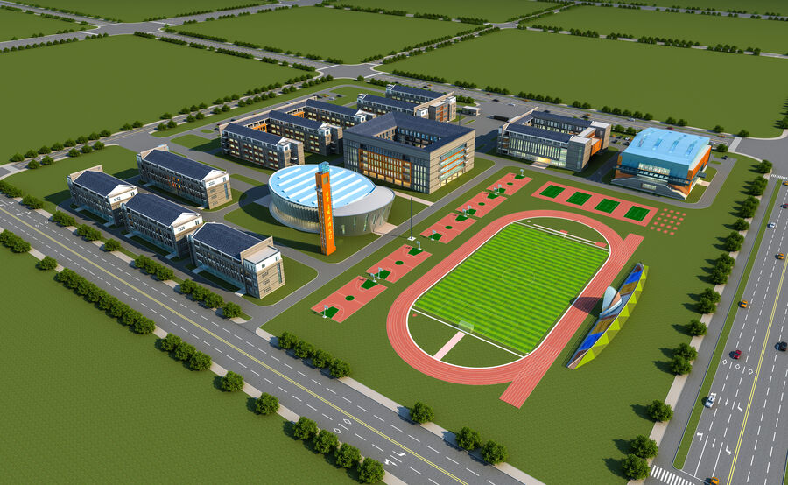
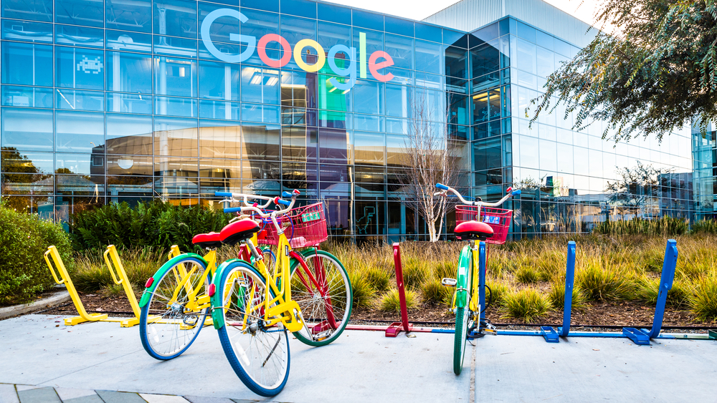
Investment opportunities
International universities
Research centres
Centres of Excellence
Leadership Academies
World-class schools
Technical and vocational institutes
Fields: artificial intelligence, blockchain, robotics, Fintech, renewable energy, ocean economy, creative arts, high tech engineering, biotechnology, life sciences, computing, healthcare among others

Slide 8
Investment Incentives
100% foreign ownership allowed
15% personal income tax rate
15% corporate tax rate
Tax free dividends
No capital gains tax
8-yrs tax holiday for top 500 institutions to set up branch campuses in Mauritius
VAT exemptions on construction of purpose-built building for the provision of tertiary education
Land conversion tax exemption for the construction of a purpose-built building for the provision of pre-primary, primary, secondary and tertiary education
Registration duty exemption on purchase of land and building to be used to provide primary, secondary and tertiary education

Slide 9
The Mauritius Africa Scholarship Scheme
Eligible to resident citizens of member states of African Union or African Commonwealth countries
Courses are open to all levels of courses:
Undergraduate diploma/degree programmes : 18-25 years’ old
Master’s programme : not more than 34 year’s old
PhD programme : not more than 44 year’s old
Scholarship covers the following expenditures:
Annual payment of tuition fees up to:
SADC: MUR 100,000
Non-SADC: MUR 160,000
Monthly living expenses : MUR 12,500
50
Total Number Of Scholarships

Slide 10
Thank You

